Slide 1
ADOPTING CI/CD Proposal

Slide 2
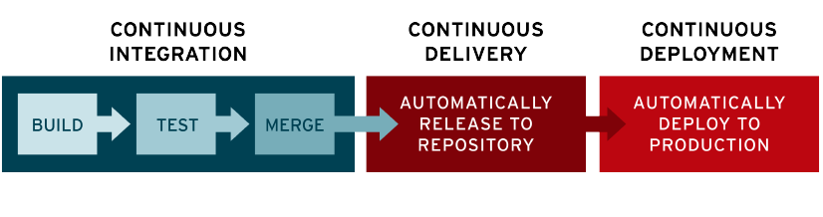
Fundamentals of ci/CD

Slide 3
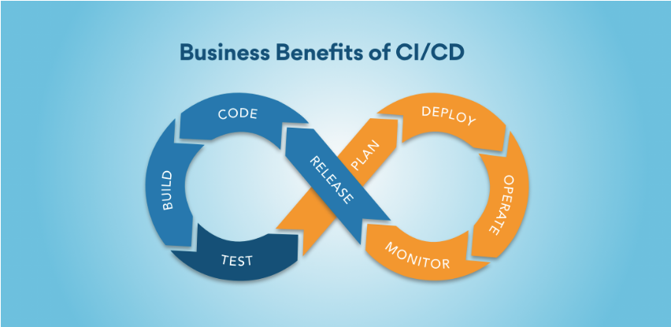
Benefits of ci/CD
Faster Software Builds
Time To Market
Efficient Developers
Reduce Cost & Protect Revenue
Reliability and Maintanence

Slide 4
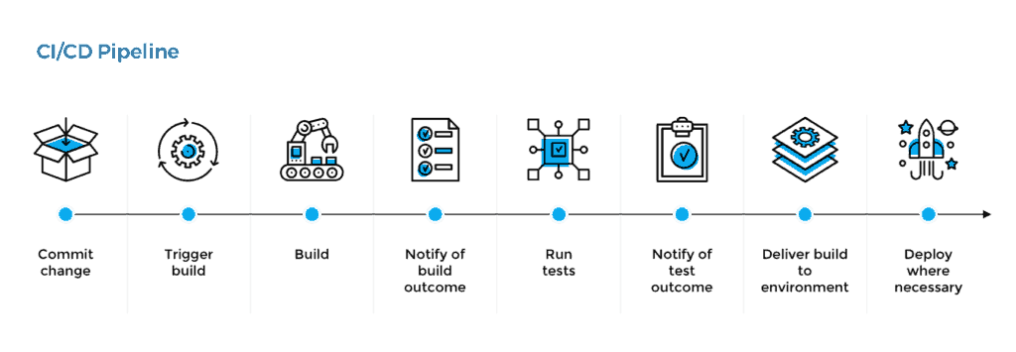
THE PROCESS

